Slide 1
An integrated high-level hardware/software partitioning methodology
By Cliff Kirkman
Notes:
The topic I have chose is integrated high-level hardware/software partitioning methodology, to begin with I am going to go through what it is, why you would want to use it, how it relates to embedded systems and then more importantly how it relates to parallel computing.

Slide 2
Introduction and Motivation
What is an hardware/software partitioning methodology?
The target technology for this methodology is Field Programmable Gate Arrays (FPGAs) and other programmable hardware
Why would you want to use hardware/software partitioning?
To save time and resources when designing systems which use programmable parts e.g. FPGAs
Speed up time-to-market
Save development costs
Easy to use design tool integrated to CAD – Designed can interact with tools to effect or modify outcome
Consideration of factors which could be missed otherwise
Partitioning happens quickly within a predictable time frame
Notes:
What is an hardware/software partitioning methodology?
When developing a product you must consider what features will be implemented using hardware and what ones will be implemented using software. There is a methodology which acts a guide line to make these decisions, during this presentation I will talk about how this process has been attempted to be automated
Via CUPSHOP Cairo University Pso-based Hardware Software partitioning tool, with a strong focus on the partial swarm optimization algorithm and how that algorithm uses parallel computing to help solve the problem.
The target technology for this methodology is Field Programmable Gate Arrays (FPGAs) and other programmable hardware
Why would you want to use one?
The main reason is to save time and resources when designing systems which use programmable parts e.g. FPGAs
This can be proven by the time it takes a product to get to market, since our industry is very fast moving this can be very important to share holders.
Using this methodology and combining it with automation and parallel computing you can save money on development costs.
CAD is a widely used piece of software which many developers are already familiar with, having this tool integrated with CAD makes it easier to use.
It can be used to help calculate development costs of a both types of implementations, buy not just the currency value but costs of all areas are considered for example: area, delay, latency, and power consumption.

Slide 3
HW/SW partitioning
Features of optimized partitioning algorithms:
Application domain, taking into consideration if the algorithm is multi-domain or specific domain
Architecture type, different approaches work differently on different architectures
Communication costs, speed at which different method communicate can be important
Choosing implementation based on alternative hardware nodes
Choosing implementation based of sharing resources amongst more than one node
Using the abilities of hardware and software parallelism
Mode type, single or multi-mode system
Decisions based on parallelization factors
Notes:
Features of optimized partitioning algorithms:
Something make work better on x86 compared to amd64, algorithm considers this.
Dependent on what embedded system you are using, hardware will likely be slower to communicate than software, speed is a factor.
Depending on which type of node you have you may want to implement differently.
Implementation based on sharing resources, between nodes, means it considers how resources will be used if the system was parallelized across a multi-node network. For example should multiple nodes need to share resources then in the design it will help to decide what the optimal amount of nodes to use is, based on cost, more details on this in next slide.
Algorithm also considers how software or hardware will parallelise tasks, some tasks are better at working in parallel on one type better than the other.
If system has to switch between different modes, this may also factor in on how it decides to allocate tasks between hardware and software.
Based on these factors the partitioning tool was built to find most efficient cost.

Slide 4
Introduction to Particle Swarm Optimization(PSO) algorithm
Using PSO to solve partitioning of hardware and software design in programmable devices
Solutions are found at random to begin with, then based on solution results over each iteration by following current best solution the most optimal one can be found
Specifically for hardware and software partitioning methodology:
Generate set of solutions with random amount of serial nodes, parallel nodes and level of power implementation
After each round based best performances, generate new set with similar amounts
Keep repeating until optimal solution is found or set number of rounds is met
Notes:
Using a PSO to solve partitioning of hardware and software design in programmable devices
Since we are limited on time this is a very brief overview of PSO, just for perspective.
PSO is an algorithm inspired by animal social behaviour like bird flocks, birds try to find food together, once some food as been found in specific area more birds look in that area. In technical terms a potential solutions move around following the path of the current best solutions.
In technical terms, based on the latest solution with highest results we use a similar data set to generate more results in that area until one is optimal solution is found.
Generate set of solutions with random amount of serial nodes, parallel nodes and level of power implementation
After each round based best performances, generate new set with similar amounts
Keep repeating until optimal solution is found or set number of rounds is met

Slide 5
How cost is considered in relation to a parallel system
When considering cost in a parallel system the main factors we look at are:
Cost of communication between nodes/threads – threads overlapping = more communication time
Nodes working in a network cluster - the delay of communicating over a network.
Should parallelisation be done on one piece of hardware with more software focus or multiple pieces of hardware to gain more power but increase costs
Using more hardware in parallel increases power consumption cost but in software this is not as important of a factor unless it’s a limited low power embedded system
Using more hardware in parallel increases area cost, meaning number of logical elements or CPU area may be a limiting factor
Notes:
Cost of communication between nodes/threads
When generating a design, the program considers how many nodes or threads to use. When using multiple nodes, if they are accessing the same parts of memory then there can be overhead which occurs when one node has to wait for another to finish its memory read/write. If a lot of overlap occurs this can increase the time and therefore the cost of operations the program has to complete.
If the optimal software design including nodes working across a cluster, then a communication cost has to be considered since you have to allow for time between these nodes, having different threads on the same CPU is faster than having different nodes operating over a network, when the task is not extensive but when you have a very extensive task you may need to consider using the power of multiple pieces of hardware.
Another factor which is considered, when adding more hardware to work in parallel is power consumption cost, there may be a limit on how much power a system can use. When considering software optimization power is not as important factor but may be considered if its limited in a low power embedded system.
Using more hardware in parallel increases area cost, meaning number of logical elements or CPU area may be limiting factor
Serial hardware implementation cost: the cost of implementing the node in serialized hardware (i.e., area) as well as its associated latency (in clock cycles). Parallel hardware implementation cost: the cost of implementing the node in parallel hardware (i.e., area) as well as its associated latency (in clock cycles). Software implementation cost: the cost of implementing the node in software (i.e., execution clock cycles and the CPU area). Communication cost: the cost of the edge if it crosses the boundary between the HW and the SW sides, i.e., interface area and delay, SW driver delay and shared memory size

Slide 6
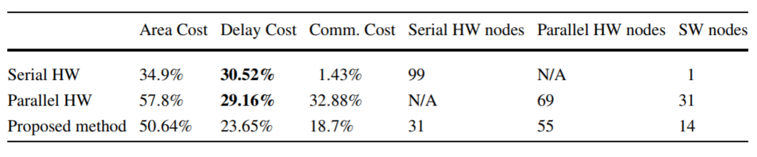
Communication cost modelling
Communication types which are used to help nodes/threads work in parallel
Point-to-point communications
Bus-based communications
Shared memory communications
Network-based communications
Example of cost modelling to determine best hardware solution according to communications:
Notes:
There are four communication types to be considered when generating a cost model.
Hardware and software communications can be separated four ways:
Point-to-point communications which means nodes connecting directly to one another
Bus-based communications which means nodes/threads communicating over system bus
Shared memory communications which is when nodes/threads use the same memory area, important to note when accessing area of memory the node must lock it off to avoid corruption.
Network-based communications, for when nodes communicate over the network.
Here is an example of some cost modelling results.
The serial line shows us the use of the least amount of area, but highest delay cost since it takes longer and a very low communication cost since there are only serial hardware nodes.
The parallel line shows the highest area cost, and lower delay meaning it completed in less clock cycles than previous. The biggest downside is the communication cost since there are a lot of nodes there has to be a lot of communication.
The proposed method shows the optimal amount of nodes to use to have the lowest delay cost. by having less nodes less communication occurred which allowed operations to compete faster.
Jigang W, Srikanthan T, Chaen G (2010) Algorithmic aspects of hardware/software partitioning: 1D
search algorithms. IEEE Trans Comput 59(4):532–544

Slide 7
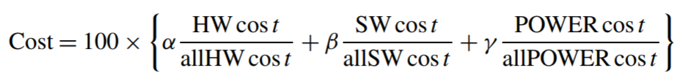
PSO Algorithm implementation
The input of the algorithm consists of a design, which contains certain amount of nodes each one has random cost values, each cost parameter is uniformly distributed
Cost range for hardware and software 1 to 99, cost range for power 1 to 9
Possible solution consists of M amount of nodes, stored in a vector each node has an indication value showing if it’s implemented as hardware or software
Notes:
(If presentation is to long remove this slide)
The input of the algorithm consists of a design, which contains certain amount of nodes each one has random cost values, each cost parameter is uniformly distributed.
Cost range for hardware and software 1 to 99, cost range for power 1 to 9
Possible solution consists of M amount of nodes, stored in a vector each node has an indication value showing if it’s implemented as hardware or software.
To calculate overall cost value, we take the weighted sum of hardware, software and power cost multiplied by 100 to make it readable.
The result of each overall cost is stored in a vector to compare with other solutions.

Slide 8
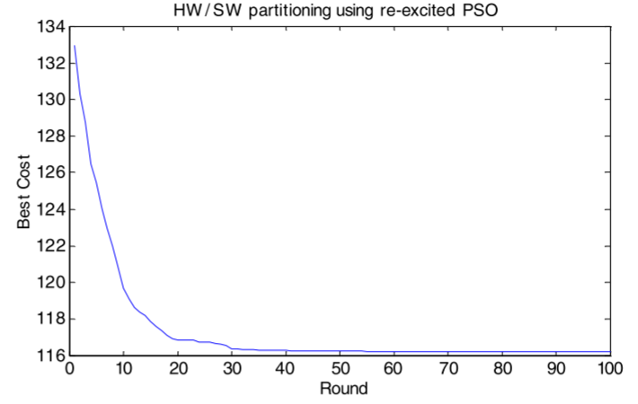
Example results of HW/SW partitioning using re-excited PSO
PSO runs again with new data holding best results from previous rounds
Generates new solution and compares against previous solutions, to help improve further improve results
Notes:
Worth noting that as apart of this paper, a altered version of PSO is used.
This re-excited PSO works by starting over, with a new set of data well keeping the best result vectors from previous rounds, this is to allow further refinement.
Essentially just giving the data set new random positions well being aware of old best solution to determine if there are any better ones to be found.
Example of improvements over PSO runs, shows after first 10 there is a dramatic increase in optimal cost, the improvements after this are minimal. It shows what an effective solution this is.
Using traditional PSO method, the cost would of ended up being 134 using re-excited method cost improved to 116.

Slide 9
Real life Case study
Purpose of case study is to test out PSO algorithm, against real world hardware and software
Based on creating a JPEG encoding system
Only RGB to YUV aspect has to already be implemented in SW, all other aspects are subject to partitioning process
Measurements have been obtained for hardware cost via implementing the HW on ML310 board using Xilinx ISE 7.1i design platform
Measurements have been obtained for software cost via Xilinx Embedded Design Kit (EDK 7.1i)
Notes:
Since this is a large paper I have chosen to cover the first of the two case studies which mainly focuses on re-excited PSO, rather than the second which focuses on the flexibility of the CUPSHOP tool as a whole.
10/32 3.4 case study
Explain JPEG coder case study
An attempt to use partitioning tool to obtain optimal hardware to software ratio
What it did, what the results were
How parallel computation effected/benefited results
Do this over two slides, figure out how it would take to present, add summary type slide if you need to extend time. Add UWE Harvard reference for pdf

Slide 10
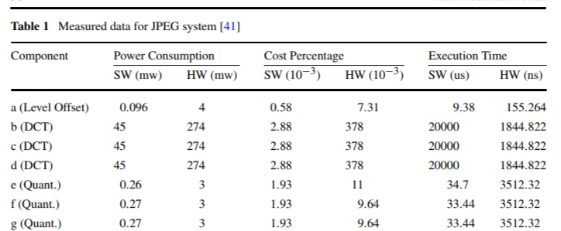
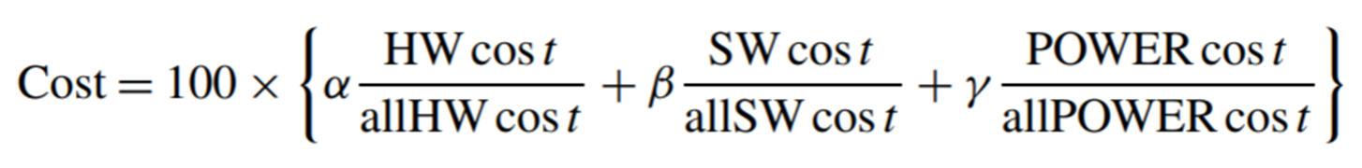
analysis of case study
Table one shows a breakdown of, Power consumption, Cost Percentage and Execution time for each component
Original algorithm was based on single core architecture, adjustments have been made to allow for multi-processor partitioning
Overall cost is generated using the same equation used in previous slides
50 solutions(particles) are attempted, a continuous loop of rounds will occur until there is no improvement for 50 rounds
Notes:
Each component has a set of values to generate cost of that individual section, we need this data to figure out how much using a particular components cost.
An adjustment is made to the algorithm to account for parallel processors, this is to alter the cost value if two or more software nodes are in the same control step, the maximum number of concurrent software tasks is two.
Since hardware components can run in parallel, the hardware delay is not additive, to calculate hardware delay by accumulating the maximum delay of each control step.

Slide 11
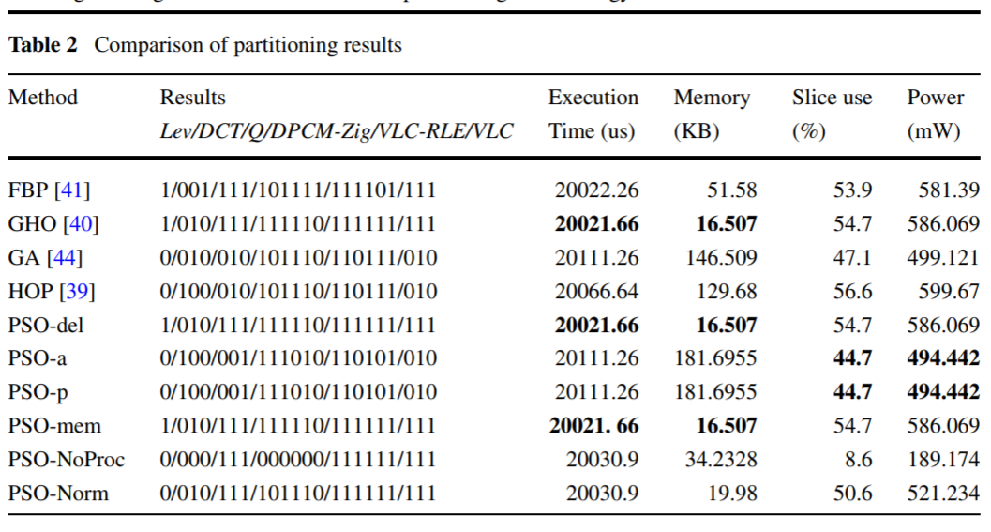
Performance analysis of case study
PSO-del, PSO-a, PSO-p, or PSO-mem only take into consideration delay, area, power or memory separately.
PSO-a and PSO-p produce the same results because they both focus on moving nodes to software
PSO-del and PSO-mem produce similar results because they both focus on moving nodes to hardware
PSO-NoProc is used to determine the optimum about of parallel processors to be used in the design
Comparing PSO-NoProc and PSO-mem you can see the main differences between doing things in parallel with hardware and software
Comparison of several different algorithms including re-excited PSO:
Notes:
Focusing on the bottom six which are all variants of the PSO algorithm, they try achieve the following:
PSO-del, PSO-a, PSO-p, or PSO-mem only take into consideration delay, area, power or memory separately, to see if optimizing by any one of these is better than optimizing by another.
PSO-a focuses on optimizing area usage and PSO-p with power usage produce the same result, this is because they both focus on moving nodes to software while adhering to the constraints of power and number of processors.
PSO-del focuses on reducing delay and PSO-mem focuses on reducing the memory usage, they both do this by trying to move nodes to hardware this is why there results are similar.
PSO-NoProc is used to determine the optimum about of parallel processors to be used in the design, when you compare the results of this to the results of the others.
Comparing PSO-NoProc and PSO-mem you can see the main differences between doing things in parallel with hardware and software
No-Proc, has much more processing power so can do more software tasks in parallel, it also uses the least amount of power when compared against all methods, since it is not using a lot of hardware components.
Mem achieves fastest execution time but it comes at the cost of using a very high amount of power, this is because the more hardware you use the more power you use. It uses less memory since more functions are completed on separate hardware modules.

Slide 12
Conclusion

Slide 13
Questions

